Slide 1


Coaching Todays Basketball Small-sided Games
Constraints Lead Approach
Ian MacLeod

Slide 2

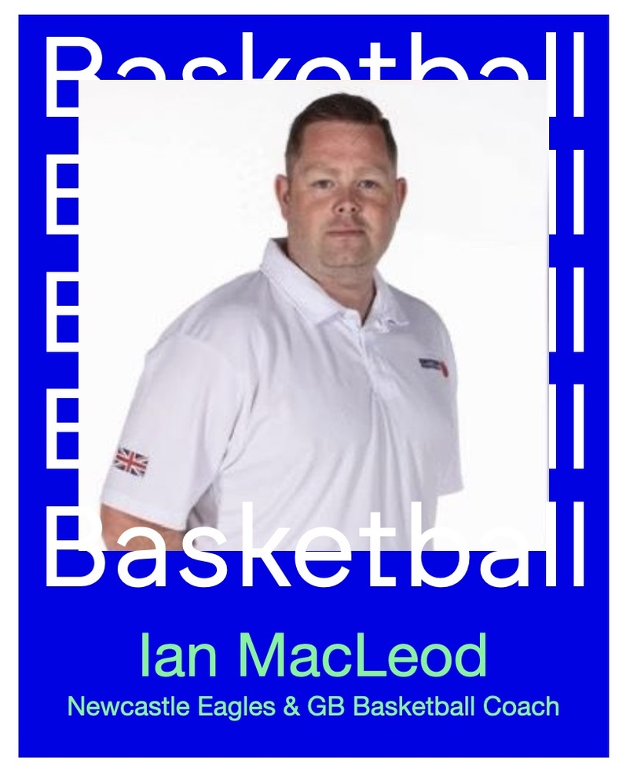
Welcome
21 years in Basketball Development in the UK
9 years as pro basketball, assistant and Head Coach in British Basketball League
11 British Basketball League winners' medals
Great Britain pathways coach at five Junior European Championships
performancepathways.co.uk

Slide 3
What is my why?
I have a passion for programme building and player & coach development.
I have dedicated 20 years of my career to providing opportunities and experiences that I was not afforded

Slide 4
Todays Basketball
So what has changed..?
The who…
The what…
The why…

Slide 5
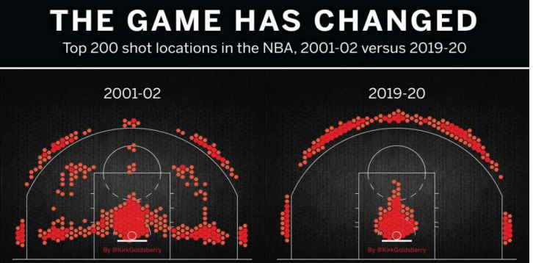
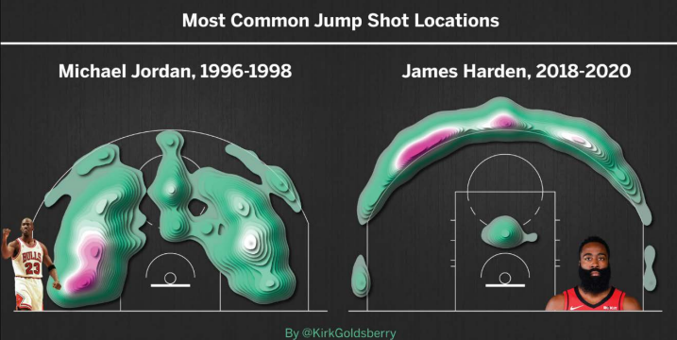
(KILCOYNE 2020, BRYANT UNIVERSITY)

Slide 6
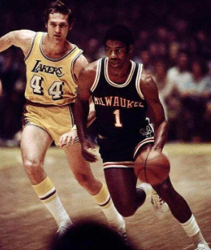
MY EXPERIENCE OF IN-SCHOOL DELIVERY
- What is taught now?
- How is it delivered?
- What type of athletes
are we creating?

Slide 7
Small-sided Games
🧱Replicating facets of the larger game
🔦Shining a light on the micro elements that underpin the macro
🤝Technical & tactical development

Slide 8
SSG Benefits
🔄More reps, more moments, more feedback
⏰Time on task
🎯Less distractions

Slide 9
SSG Pitfalls
🥱 Familiarity
🛌 Becoming comfortable
👀 Number of eyes (coaches)
🧭 Changes of direction

Slide 10
Constraints Lead Approach
🔐 Defined problems > creating solutions
💭 Develops players decision making skills
🌤🌡Coaches have environmental control / responsibility

Slide 11
CLA Benefits
📍 Pin-point specific aspects to work on
🚐Athlete dictates the journey
💬Reviews & feedback more targeted & on-task

Slide 12
CLA Pitfalls
🏃‍♀🚶‍♀Running before walking ?
😵‍💫 What constraints? The how? Experience level?
📉 Be ready to regress in order to progress

Slide 13
Interactions
Must underpin problem solving and decision making ethos present in SSG & CLA practice design

Slide 14
What does it look like?
Ask more than you tell
Expand
Justify
Challenge
Summative response

Slide 15

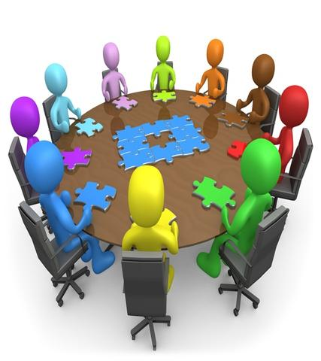
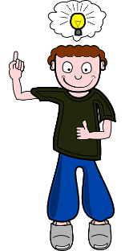
The Rule of Three
Mark Bennett, MBE @PDSCoach
Level 3:
Players are not communicating and not searching for solutions. Coach must intervene
Level 2:
Teammates supporting each-other to find solutions, offer praise & challenge. Holding each other accountable
Level 1:
Individual players coming up with solutions. Self-regulation

Slide 16
Q&A
The deaded silence…

